Slide 1
MULTI STAGE GATING FOR TOKEN OPTIMIZATION AND MEMORY MANAGEMENT
MAIN PROJECT PHASE 2
Artificial Intelligence & Data Science – ADD 416 (Project Phase 2)
05/02/2026
01

Slide 2





Our Team
Annu Jaison
SJC22AD018
Aaron Johns
SJC22AD001
Dr. Renjith Thomas
Associate Professor; HOD AD Dept.
Adith Abhilash
SJC22AD008
Pooja Shibu
SJC21AD048
Artificial Intelligence & Data Science – ADD 416 (Project Phase 2)
05/02/2026
02

Slide 3
TABLE OF CONTENTS
{01}
INTRODUCTION
{02}
PROBLEM STATEMENT
{03}
OBJECTIVES
{04}
LITERATURE SURVEY/EXISTING SYSTEMS
{05}
PROPOSED METHODOLOGY AND SOLUTION
{06}
TOOLS AND TECHNOLOGIES
{07}
SCOPE OF THE PROJECT
{08}
EXPECTED OUTPUT
{09}
CONCLUSION
{10}
REFERENCES
Artificial Intelligence & Data Science – ADD 416 (Project Phase 2)
05/02/2026
03

Slide 4
INTRODUCTION
Real World Relevance
LLMs power agents, assistants, chatbots
Need full context every prompt
Memory grows with each query
Causes token overflow and noise
Inference cost and latency increase
Performance degrades with irrelevant info
Artificial Intelligence & Data Science – ADD 416 (Project Phase 2)
05/02/2026
04

Slide 5
INTRODUCTION
Motivation
Existing memory methods are naive
Injects all past data blindly
Wastes tokens, slows down output
Requires smarter, relevant memory selection
Optimise prompt, retain answer quality
Adaptive system needed for relevance
Artificial Intelligence & Data Science – ADD 416 (Project Phase 2)
05/02/2026
05

Slide 6
PROBLEM STATEMENT
Current State
LLMs are stateless and verbose
Context windows are limited (4k–32k)
Naive memory causes token bloat
High cost, low response accuracy
Static prompts don't scale well
Needs real-time, dynamic filtering
Artificial Intelligence & Data Science – ADD 416 (Project Phase 2)
05/02/2026
06

Slide 7
OBJECTIVES
Token Efficiency
Hybrid
Gating
Response Quality
Minimise token usage efficiently
Use multiple gating strategies
Maintain or improve response quality
Visual Monitoring
Dynamic Monitoring
Easy Deployment
Provide visual feedback to users
Learn memory relevance dynamically
Deploy a plug-and-play system
Artificial Intelligence & Data Science – ADD 416 (Project Phase 2)
05/02/2026
07

Slide 8
LITERATURE REVIEW/EXISTING SYSTEMS
Method | Memory Reduction | Throughput Gain | Requires Tuning | Key Strength | Alignment with Token Optimiser
KVPruner | ~50% | ~35% | ✅ Yes | Sensitivity-based channel pruning | Gating logic inspiration
PyramidInfer | ~54% | ~2.2× | ❌ | Layer-wise pruning | Hierarchical relevance modeling
RazorAttention | >70% | ~3×+ | ❌ | Head-based attention filtering | Attention-driven gating logic
R‑KV | ~84–90% | ~6.6× | ❌ | CoT reasoning specificity | Redundancy-aware gating principles
Cache‑Craft | N/A | Huge (system) | ❌ | Chunk reuse for RAG efficiency | Efficient memory reuse in conversations
Artificial Intelligence & Data Science – ADD 416 (Project Phase 2)
05/02/2026
08

Slide 9
PROPOSED METHODOLOGY/SOLUTION
Query → Memory → Gating → Prompt
Only top-K relevant entries injected
Prompt sent to LLM API
Response updates memory (optional)
Fast, adaptive, cost-effective pipeline
Uses embeddings, attention, classifiers
Artificial Intelligence & Data Science – ADD 416 (Project Phase 2)
05/02/2026
09

Slide 10
PROPOSED METHODOLOGY/SOLUTION
User Input
Chat History
M1
M2
M3
M4
External
Documents
Context window
M5
M6
M7
M8
M9
M10
M11
M12
LLM
M13
M14
M15
M16
Answer
Artificial Intelligence & Data Science – ADD 416 (Project Phase 2)
05/02/2026
10

Slide 11
PROPOSED METHODOLOGY/SOLUTION
User Input
Chat History
Token Gater
M1
M2
M3
M4
External
Documents
Context window
M1
M7
M5
M6
M7
M8
M9
M16
M9
M10
M11
M12
LLM
M13
M14
M15
M16
Answer
Artificial Intelligence & Data Science – ADD 416 (Project Phase 2)
05/02/2026
11

Slide 12
TOOLS AND TECHNOLOGIES
EMBEDDING
LLM APIs
BACKEND
OpenAI, Sentence Transformers
GPT-4, Claude, LLaMA
Redis, ChromaDB, JSON
UI & METRICS
GATING MODELS
ORCHESTRATION
Streamlit, WandB
scikit-learn, PyTorch
LangChain, Python,
MCP
Artificial Intelligence & Data Science – ADD 416 (Project Phase 2)
05/02/2026
12

Slide 13
SCOPE OF THE PROJECT
PROBLEM
CHALLENGE
LLM agents struggle with context overload and token inefficiency
Designing a memory system that adapts across domains and data types
SOLUTION
RESULTS
A modular, pluggable architecture supporting text memory, user learning
Scalable system for academic and enterprise use; ready for publication and deployment
Artificial Intelligence & Data Science – ADD 416 (Project Phase 2)
05/02/2026
13

Slide 14
ARCHITECTURE
server.py
test_api.py
api.py
test_gating.py
token_gater.py
settings.py
test_retriever.py
retriever.py
memory_provider.py
sample_memory.jsonl
models.py
utils.py
prompt.py
README.md
bench_run.py
requirements.txt
embed_index.py
Dockerfile
.env.example
evaluator.py
.gitignore
Artificial Intelligence & Data Science – ADD 416 (Project Phase 2)
05/02/2026
14

Slide 15
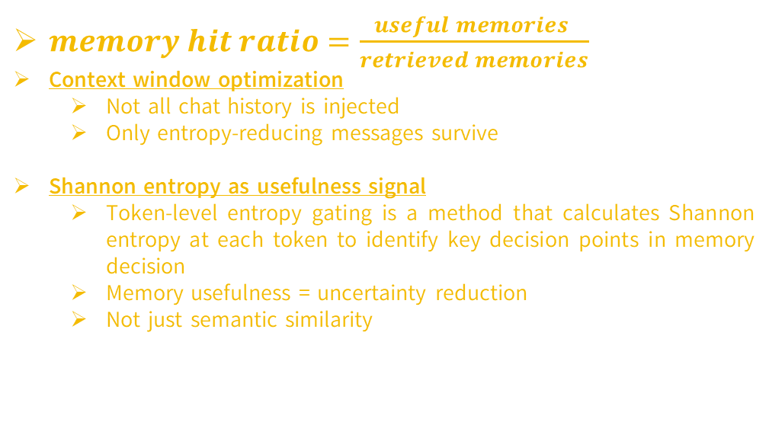
GATING ALGORITHM
$memory hit ratio=\frac{useful memories }{retrieved memories}$
Context window optimization
  Not all chat history is injected
  Only entropy-reducing messages survive
Shannon entropy as usefulness signal
  Token-level entropy gating is a method that calculates Shannon entropy at each token to identify key decision points in memory decision
  Memory usefulness = uncertainty reduction
  Not just semantic similarity
Artificial Intelligence & Data Science – ADD 416 (Project Phase 2)
05/02/2026
15

Slide 16
THEORY OF EVALUATION
Here, the cost of a single inference attempt, Cm(p), is defined as:
Cₘ(p) = nᵢₙ(m,p) . cᵢₙ(m) + nₒᵤₜ(m,p) . cₒᵤₜ(m)
where nin(m,p) and nout(m,p) are the number of input and output tokens for model m on problem p
cin(m) and cout(m) are the per-token costs for input and output
Artificial Intelligence & Data Science – ADD 416 (Project Phase 2)
05/02/2026
16

Slide 17
EVALUATION CRITERIA
INPUT TOKENS
TIME (S)
Tokens in the gated prompt
Total time taken for the model to return an answer
OUTPUT TOKENS
TOKENS PER SECOND (TPS)
Tokens generated by the model
Throughput metric of tokens processed per second; higher means more efficient.
Artificial Intelligence & Data Science – ADD 416 (Project Phase 2)
05/02/2026
17

Slide 18
EXPECTED OUTCOME
EFFICIENCY GAINS
INTELLIGENT RESPONSIVENESS
Reduced prompt size and lower inference cost
Fast, relevant outputs via adaptive memory controller
PERFORMANCE MONITORING
DEPLOYMENT & RESEARCH VALUE
Dashboard visualizing token savings and latency
Streamlit demo interface and publishable research results
Artificial Intelligence & Data Science – ADD 416 (Project Phase 2)
05/02/2026
18

Slide 19
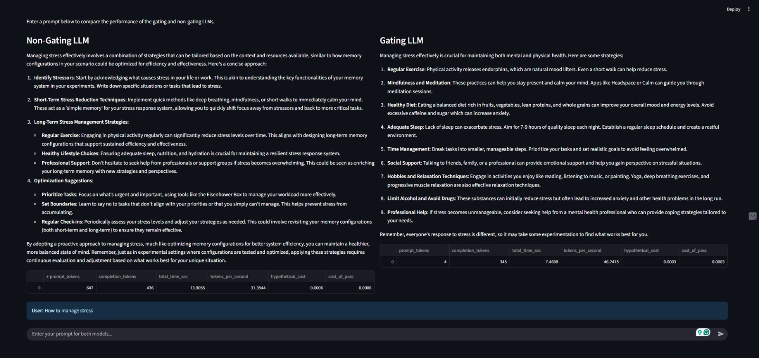
RESULT AND DISCUSSION
Artificial Intelligence & Data Science – ADD 416 (Project Phase 2)
05/02/2026
19

Slide 20
RESULT AND DISCUSSION
User Prompt: How to manage stress
Parameters | Non-Gating LLM | Gating LLM | Improvement
Prompt tokens | 647 | 4 | ↓ 99.38%
Completion tokens | 436 | 345 | ↓ 20.87%
Total Time (in sec) | 13.9055 | 7.4608 | 46.35% faster
Tokens per second | 31.3544 | 46.2415 | ↑ 47.47%
Hypothetical cost | 0.0006 | 0.0003 | ↓ 50%
Cost of pass | 0.0006 | 0.0003 | ↓ 50%
Artificial Intelligence & Data Science – ADD 416 (Project Phase 2)
05/02/2026
20

Slide 21
CONCLUSION
Smart memory management for LLMs
Injects only relevant context chunks
Combines embeddings, attention, classifiers
Reduces costs, improves response clarity
Practical, research-worthy, and scalable
Elevates LLM agents’ effectiveness
Artificial Intelligence & Data Science – ADD 416 (Project Phase 2)
05/02/2026
21

Slide 22

CHOSEN JOURNAL PAPER
Artificial Intelligence & Data Science – ADD 416 (Project Phase 2)
05/02/2026
22

Slide 23
REFERENCES
Bo Lv, Quan Zhou, Xuanang Ding, Yan Wang & Zeming Ma. KVPruner: Structural Pruning for Faster and Memory‑Efficient Large Language Models. arXiv, Sept 2024.
Dongjie Yang, Xiaodong Han, Yan Gao, Yao Hu, Shilin Zhang & Hai Zhao. PyramidInfer: Pyramid KV Cache Compression for High‑throughput LLM Inference. Findings of ACL 2024.
Zefan Cai et al. PyramidKV: Dynamic KV Cache Compression based on Pyramidal Information Funneling. arXiv, June 2024.
Hanlin Tang et al. RazorAttention: Efficient KV Cache Compression Through Retrieval Heads. arXiv, July 2024.
Zefan Cai et al. R‑KV: Redundancy‑Aware KV Cache Compression for Training‑Free Reasoning Models Acceleration. arXiv, May 2025.
Agarwal et al. Cache‑Craft: Chunk‑Level KV Cache Reuse for Faster and Efficient RAG. SIGMOD 2025.
Artificial Intelligence & Data Science – ADD 416 (Project Phase 2)
05/02/2026
23

Slide 24
Thanks!
Do you have any questions?
Artificial Intelligence & Data Science – ADD 416 (Project Phase 2)
05/02/2026
24

